Slide 1

Mini Portofolio
Veronica Yolanda
Exercise 1
Intensive Bootcamp Data Science
by @myskill.id

Slide 2
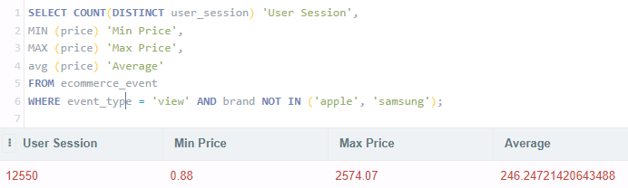
Mini Task 1
From the ecommerce_event table, write a SQL query to output:
Total Unique user_session
Min, Max, and Average price
With criteria event_type is view, and brand except apple and samsung

Slide 3
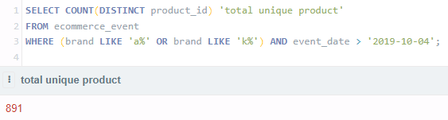
Mini Task 1
2. From the ecommerce_event table, write a SQL query to output Total Unique product_id .
Filter brand which start with ‘a’ or ‘k’ letter, and date after ‘2019-10-04’

Slide 4
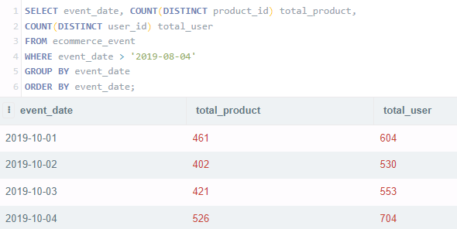
Mini Task 1
3. From the ecommerce_event table, write a SQL query to output total unique product and total unique user, for every order date. Only show the date above 04 august 2019, and sort the result by the latest date

Slide 5
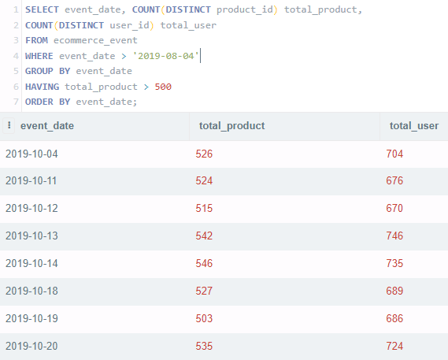
Mini Task 1
4. From the question 3, filter only dates that have total_product more than 500

Slide 6
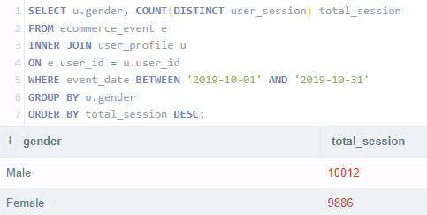
Mini Task 1
5. From the event and user table, which gender has more sessions in october 2019?

Slide 7
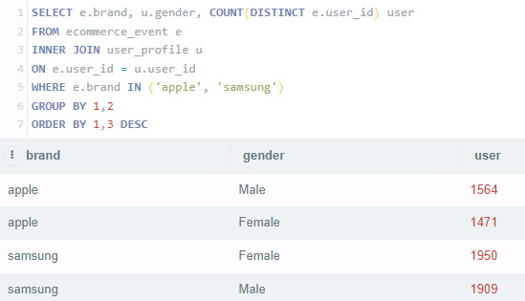
Mini Task 1
6. From the event and user table, is it true that iphone has more dominated by female and samsung dominated by male?
Answer : False

Slide 8
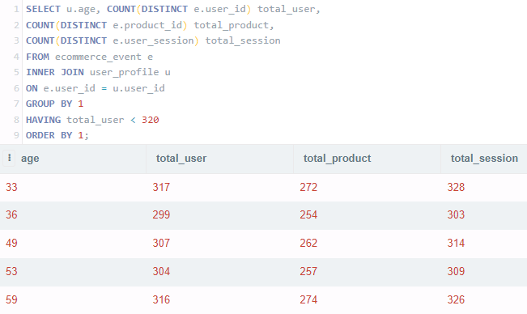
Mini Task 1
7. From the event and user table, show total user, product, and session, in every ages. Exclude age with total_user more than 320

Slide 9
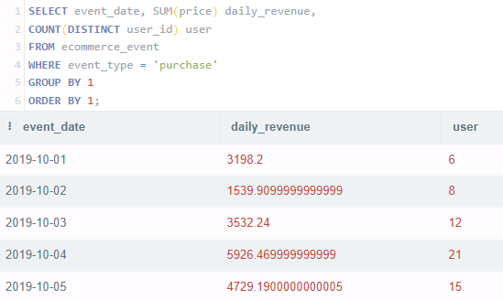
Mini Task 1
8. Calculate the daily revenue and unique users for each date

Slide 10
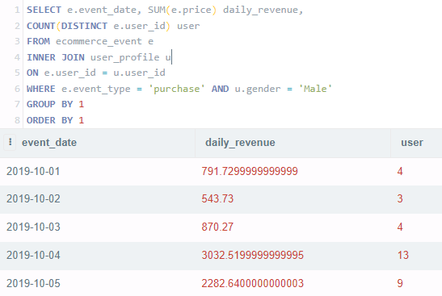
Mini Task 1
9. Calculate the daily revenue and unique users for each date for male users

Slide 11
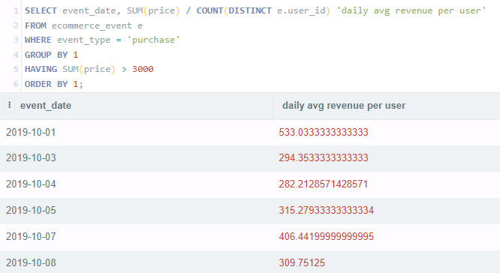
Mini Task 1
10. Calculate the daily average revenue per user (Revenue/ # users) for date with revenue higher than 3000

Slide 12

Follow me!
Instagram : veyyola
LinkedIn : linkedin.com/in/veronicayolanda/
Intensive Bootcamp Data Science
by @myskill.id

